Slide 1
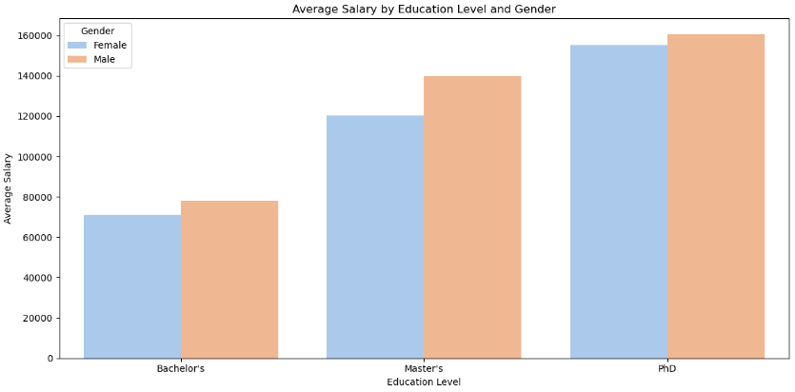
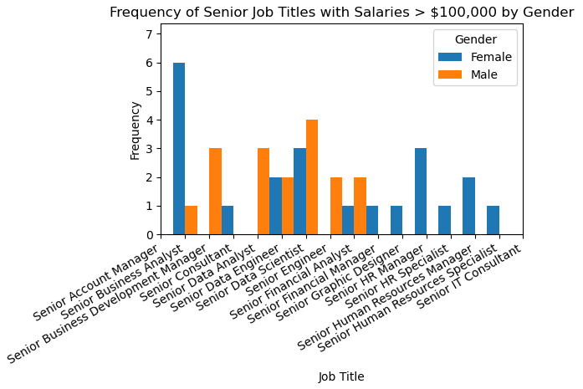
Gender Disparities Within Salaries
Data Shows that males are making more money than women at every education level. However, women in senior positions surpass the $100,000 salary threshold at a greater frequency than their male counterparts.
Key Findings:
Only occurrence of women out earning mean are between ages of 20-30.
Note the large jump in women’s salaries from Master’s degree to PhDs, however still less than men’s.
Overall averages for salaries at all three education levels are within a 20,000 range.
Data Source: Kaggle, Salary Prediction Salary Prediction dataset (kaggle.com)

